Slide 1
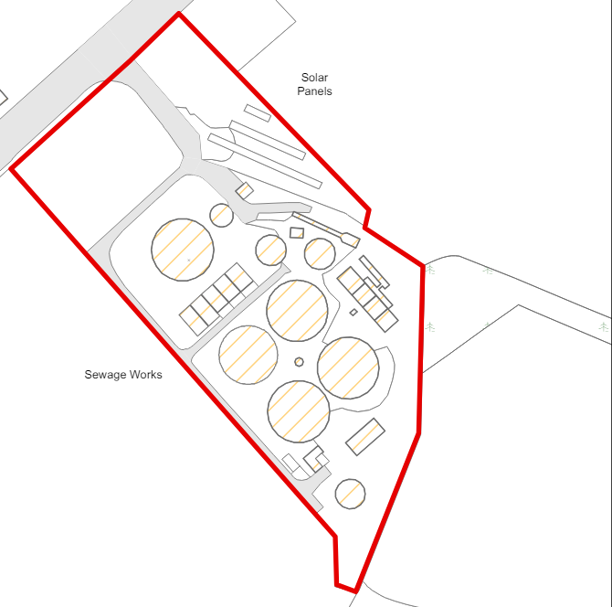
Preliminary Treatment
Inlet works
Storm Water Management
Sludge Holding Tank
Inlet works
Balancing Tank
PSTs
Storm Tanks
Storm Tanks
Primary Treatment
5
1
2
1
PSTs
Sludge Holding Tank
2
Balancing Tank
4
3
3
1
Filter Beds
2
Filter Beds
Humus Tanks
2
1
Humus Tanks
Secondary Treatment
3
FE Discharge

